Slide 1
Learn .
GROW .
PLAY.
How our app addresses the issue psychologically?

Slide 2

PROBLEMS SOLVED
The most effective learning children do is through play .
ADDRESSING SPEECH AND LANGUAGE DELAY :
1 .speech correction thro TTS and STT technology .
2. Homophones teaching .

Slide 3
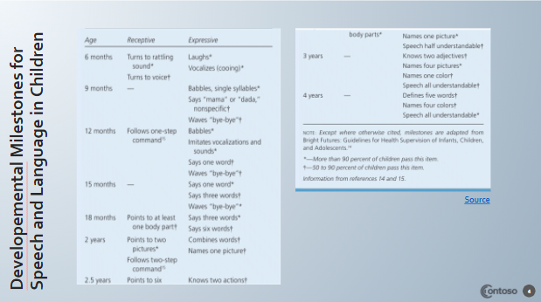

Slide 4
HOW IT HELPS CHILDREN?
child must practice speaking to get better at it. it helps to use all the senses when learning how to say sounds.
child uses “visual” cues, like looking into the camera when making sounds;
or "listening” cues, like practicing sounds with TTS and STT and then listening to hear if the sounds were made correctly.
app can provide auditory and visual feedback to help your child learn how to form sounds. In addition, your child can hear their own sound productions for comparison

Slide 5
IMPACT ON KIDS
ADDRESSING HOLISTIC DEVELOPMENT :
Tasks for relationship building
Moral building
Confidence building
Not autonomous app ,we are accountable. We work together with parent and school to decide tasks

